Slide 1
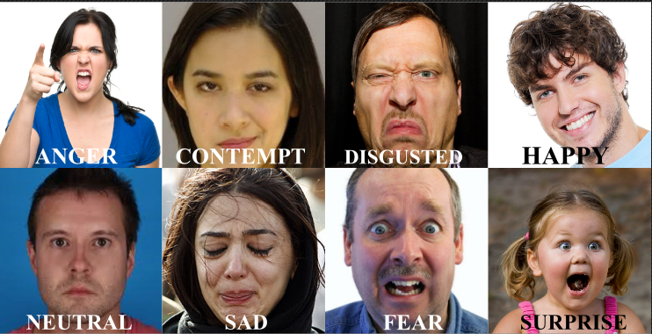
EMOTION RECOGNITION USING IMAGE PROCESSING IN DEEP LEARNING WITH PYTHON.
VISHNU V
ROLL N0 :60
REGISTRATION NO:LMGP16MCA061
DEPT OF COMPUTER APPLICATIONS
SAINTGITS COLLEGE OF ENGINEERING

Slide 2
ABSTRACT
User’s emotion using its facial expressions will be detected. These expressions can be derived from the live feed via system's camera or any pre-existing image available in the memory. Emotions possessed by humans can be recognized and has a vast scope of study in the computer vision industry upon which several researches have already been done.
We propose a compact CNN model for facial expression recognition.
The work has been implemented using Python Open Source Computer Vision Library (OpenCV) and NumPy,pandas,keras packages. The scanned image (testing dataset) is being compared to training dataset and thus emotion is predicted.

Slide 3
OBJECTIVES
The objective of this paper is to develop a system which can analyze the image and predict the expression of the person.
Development of this software is more useful for police officers to predict the current emotional state of prisoners and criminals.
This project is also useful for doctor's to predict expression of children which are affected by autism.
The major application of this work would be to predict a person’s emotion based on his face images, video frames etc. This can even be applied for evaluating the public option relating to a particular movie form the video reaction posts on social Medias.

Slide 4
CHALLENGES
low-intensity expressions which are difficult to distinguish with insufficient image resolution.
Data collection for facial expression recognition is expensive and time-consuming.
Recognizing precise expression from a variety of expression forms of different people would be a huge problem. To solve this problem, this project generates an Emotion Detection Model to extract emotion from video frame image input.

Slide 5
FACIAL EXPRESSION
Facial expression is one of the most powerful, natural and universal signals for human beings to convey their emotional states and intentions.
The frame-to-sequence approach successfully exploits temporal information and it improves the accuracies on the public benchmarking databases.
Prototypical facial expressions are anger, disgust, fear, happiness, sadness, neutral and surprise. Contempt was subsequently added as one of the basic emotions.
Behaviors, actions, poses, facial expressions and speech; these are considered as channels that convey human emotions.

Slide 6
STEPS IN PROCESS
This work mainly focuses on psychological approach of COLOUR CIRCLE-EMOTION relation to find the accurate emotion behind the video frame input image (image input).
At first the whole image will be image preprocessed and pixel by pixel data studied.
The combinations of these circles based on combined data will result into a new color.
This resulted color will be directly linked to a particular emotion..

Slide 7
PACKAGES USED
Numpy- NumPy is a library for the Python programming language, adding support for large, multi-dimensional arrays and matrices, along with a large collection of high-level mathematical functions to operate on these arrays.
Scipy-SciPy is a free and open-source Python library used for scientific computing and technical computing. SciPy contains modules for optimization, linear algebra, integration, interpolation, special functions, FFT, signal and image processing, ODE solvers and other tasks common in science and engineering.
Mathplotlib- Matplotlib is a Python 2D plotting library which produces publication quality figures in a variety of hardcopy formats and interactive environments across platforms.
Opencv- OpenCV is a Python library which is designed to solve computer vision problems. OpenCV supports a wide variety of programming languages such as C++, Python, Java etc. Support for multiple platforms including Windows, Linux, and Mac OS.

Slide 8
PACKAGES USED
Pandas- pandas is an open source, BSD-licensed library providing high-performance, easy-to-use data structures and data analysis tools for the Python programming language. pandas is a NumFOCUS sponsored project. This will help ensure the success of development of pandas as a world-class open-source project, and makes it possible to donate to the project.
Theano-Theano is a Python library that allows you to define, optimize, and evaluate mathematical expressions involving multi-dimensional arrays efficiently. Theano features: tight integration with NumPy, transparent use of a GPU , efficient symbolic differentiation , speed and stability optimizations, dynamic C code generation, extensive unit-testing and self-verification
Keras- Keras is an open-source neural-network library written in Python. It is capable of running on top of Tensor Flow, Microsoft Cognitive Toolkit, Theano, or PlaidML. Designed to enable fast experimentation with deep neural networks, it focuses on being user-friendly, modular, and extensible.

Slide 9
PACKAGES USED
Seaborn- Seaborn is a Python data visualization library based on matplotlib. It provides a high-level interface for drawing attractive and informative statistical graphics.
H5py- The h5py package is a Pythonic interface to the HDF5 binary data format.HDF5 lets you store huge amounts of numerical data, and easily manipulate that data from NumPy.
Tensor flow-Tensor Flow is a free and open-source software library for dataflow and differentiable programming across a range of tasks. It is a symbolic math library, and is also used for machine learning applications such as neural networks.
Python-dateutil-The dateutil module provides powerful extensions to the standard date time module, available in Python 2.3+.
Pytz- pytz brings the Olson tz database into Python. This library allows accurate and cross platform time zone calculations using Python 2.4 or higher. It also solves the issue of ambiguous times at the end of daylight saving time.

Slide 10
PACKAGES USED
Pyyaml-YAML is a data serialization format designed for human readability and interaction with scripting languages.PyYAML is a YAML parser and emitter for the Python programming language.

Slide 11
WORKING
This paper proposes a prototype system which automatically recognizes the emotion represented on a face.
Thus a neural network based solution combined with image processing is used in classifying the universal emotions.
Happiness, Sadness, Anger, Disgust, Surprise and Fear. Colored frontal face images are given as input to the prototype system.
There are basically 22 expression are there ,for our purpose we only use basic 7 emotions.

Slide 12
WORKING
After the face is detected, image processing based feature point extraction method is used to extract a set of selected feature points.
Finally, a set of values obtained after processing those extracted feature points are given as input to the neural network to recognize the emotion contained .
The three main steps that are common in automatic deep FER, i.e., pre-processing, deep feature learning and deep feature classification.

Slide 13
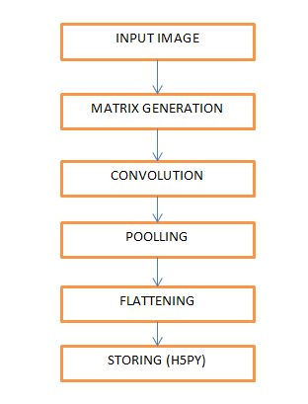
WORKING
Matrix generation from given images
Convolution
Pooling
Flattening
Storing (H5py)

Slide 14
MODULES
Module 1:- Data analysis
Module 2:- Training the dataset
Module 3:-Data identification

Slide 15
FUTURE ENHANSEMENT
User’s emotion using its facial expressions will be detected. These expressions can be derived from the live feed via system's camera or using web cameras.

Slide 16
HARDWARE REQUIREMENTS
TRAINING
System with min of 16 GB ram
Processor I5 or above
Minimum 5 GB memory required.
TESTING
System with min of 4 GB ram
Processor I3 or above
Minimum 5 GB memory required.

Slide 17
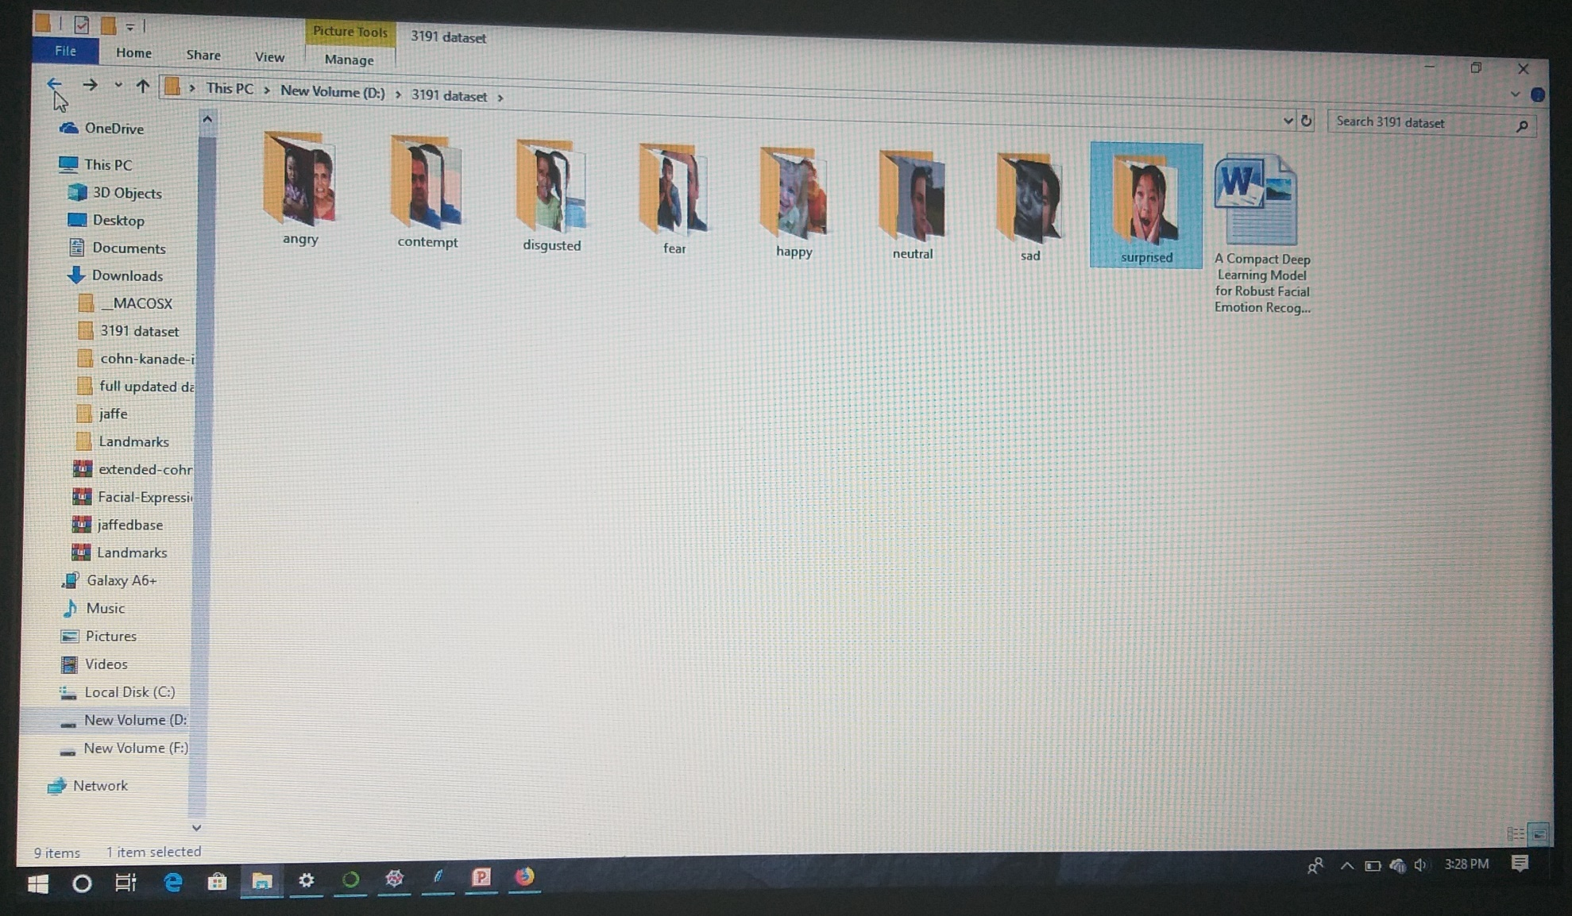
EXPERIMENTS WITH DATASET
DATASET

Slide 18
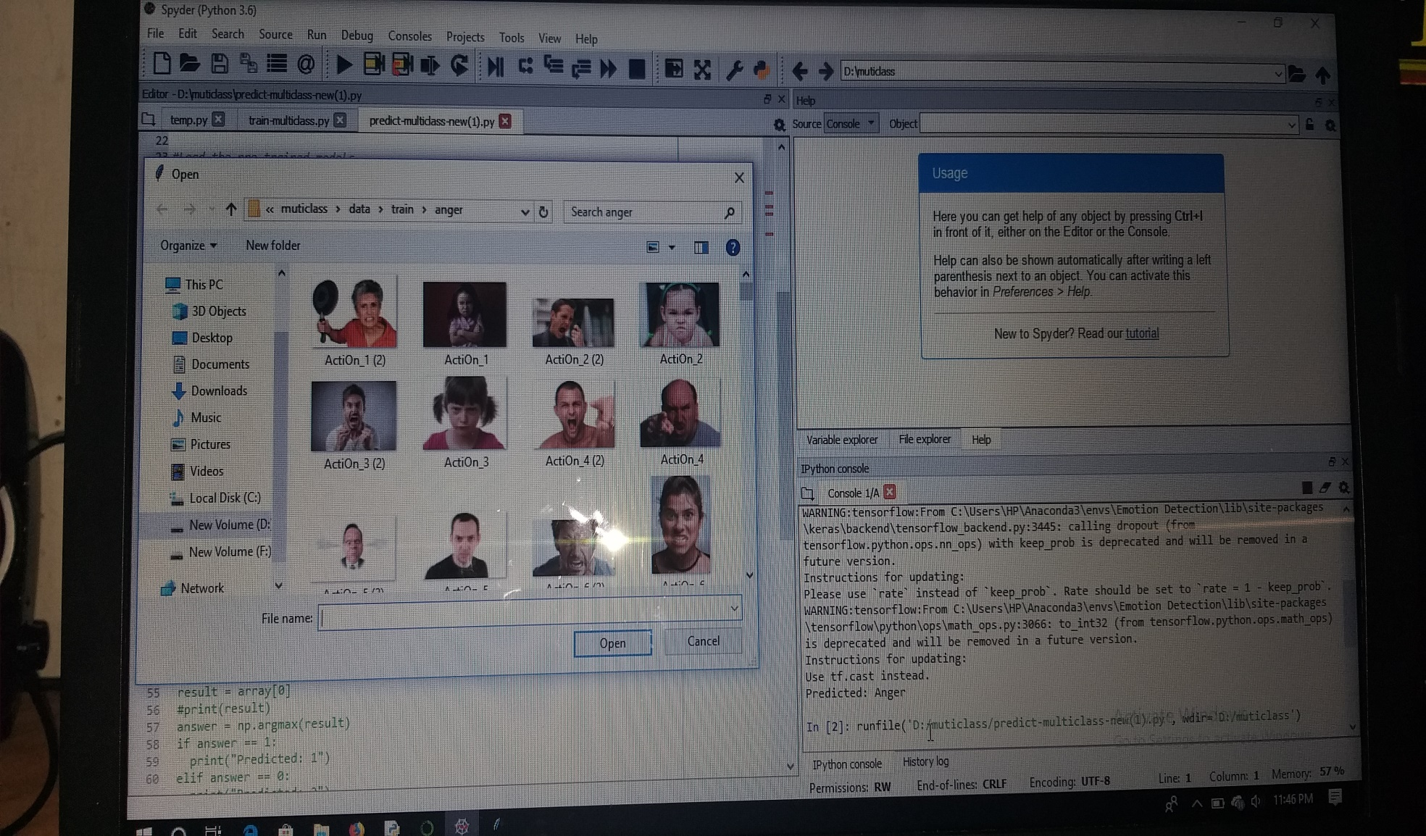
SCREEN SHOTS
ANGER

Slide 19
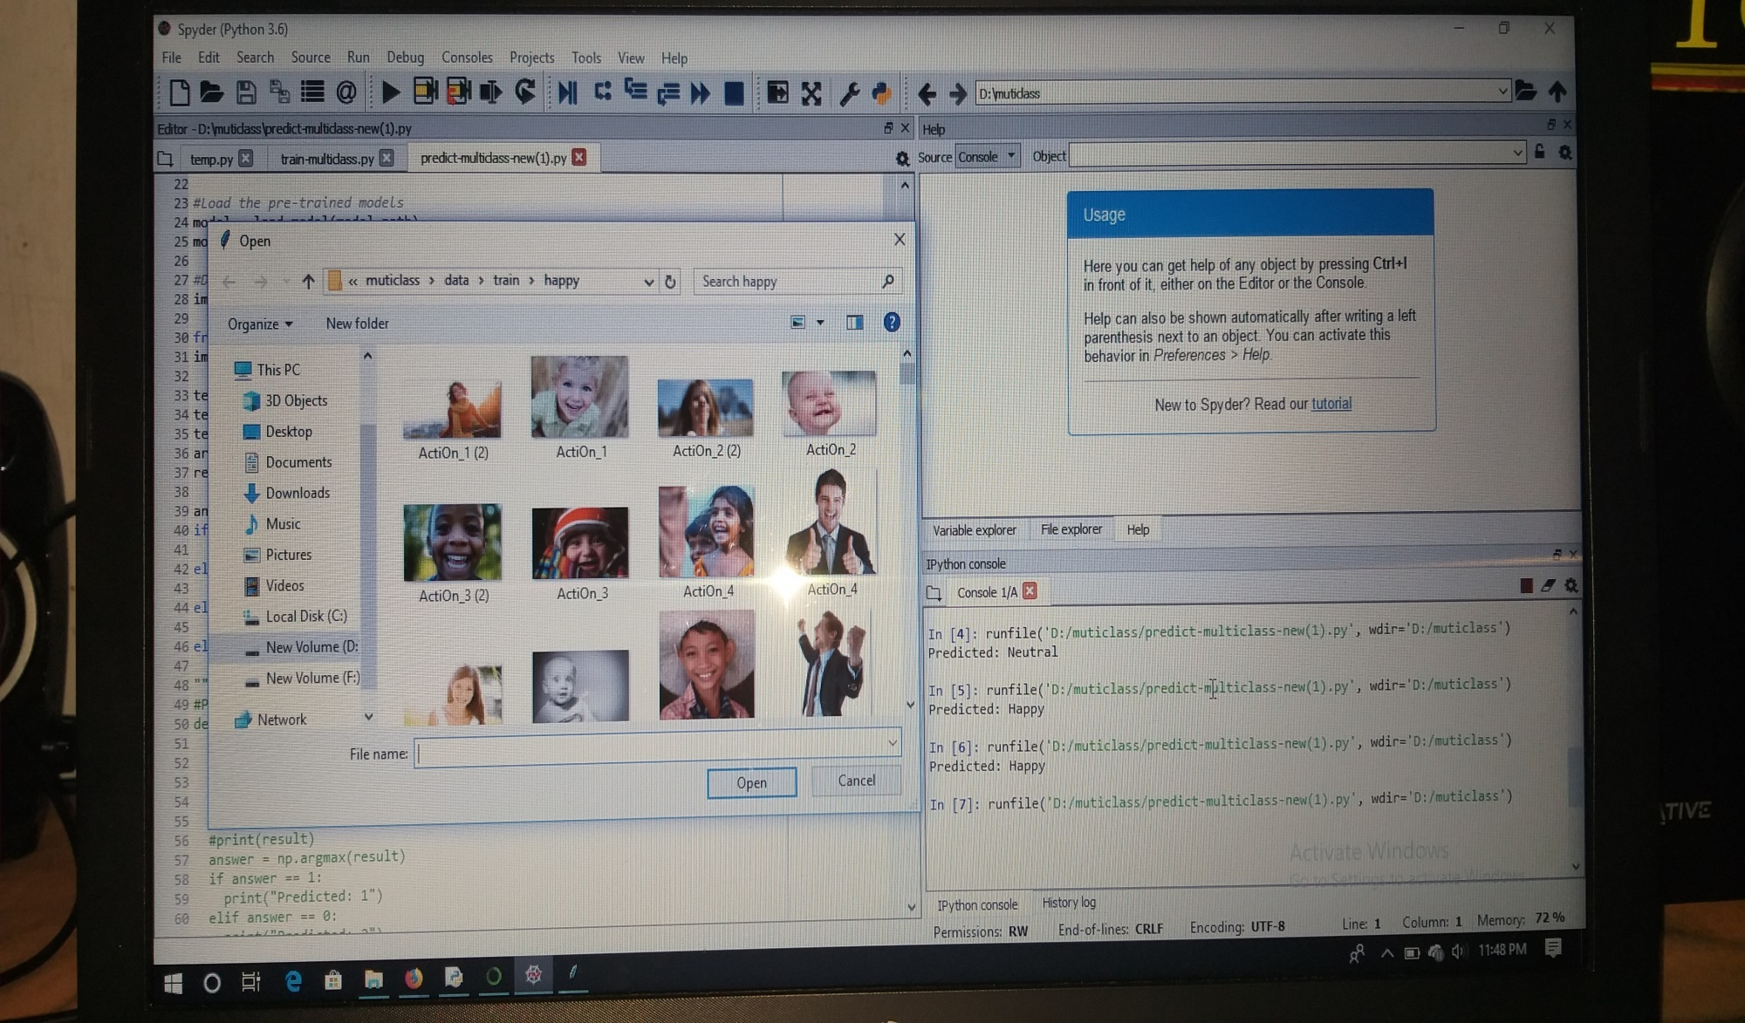
SCREEN SHOTS
HAPPY

Slide 20
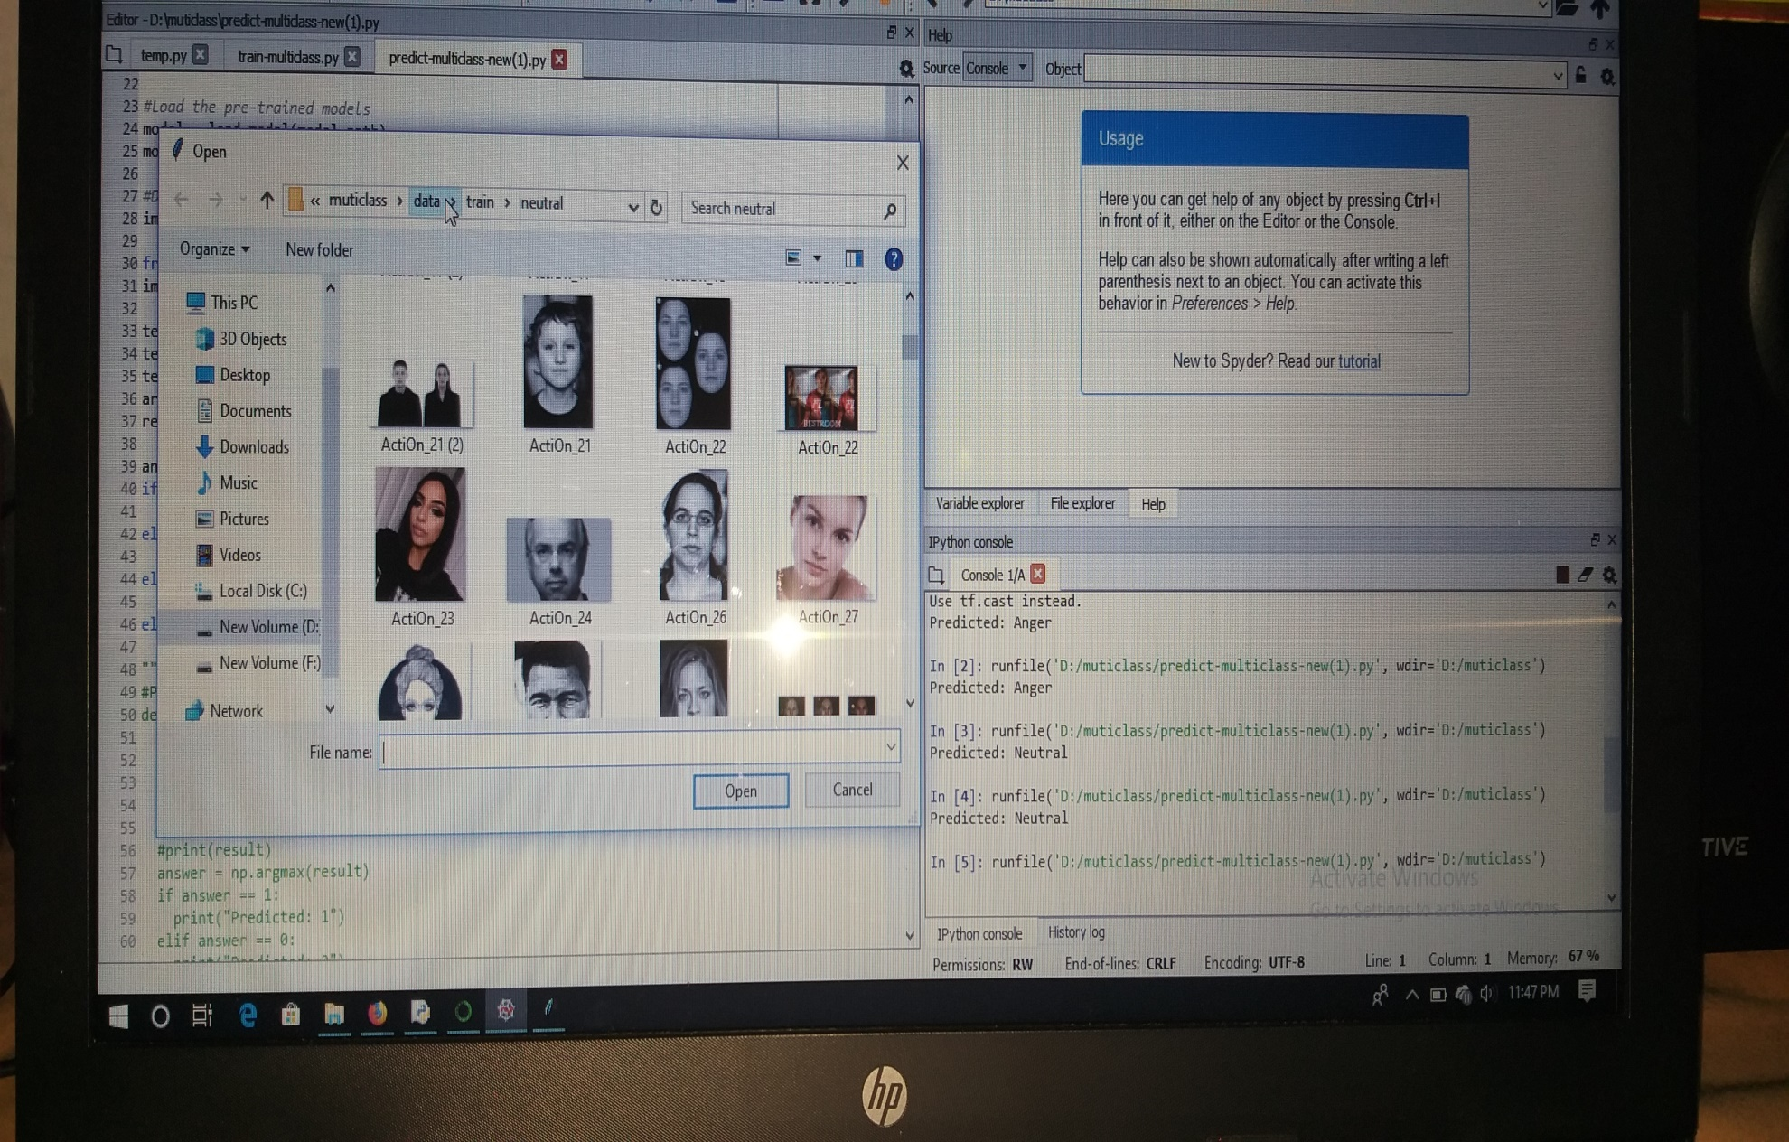
SCREEN SHOTS
NEUTRAL

Slide 21
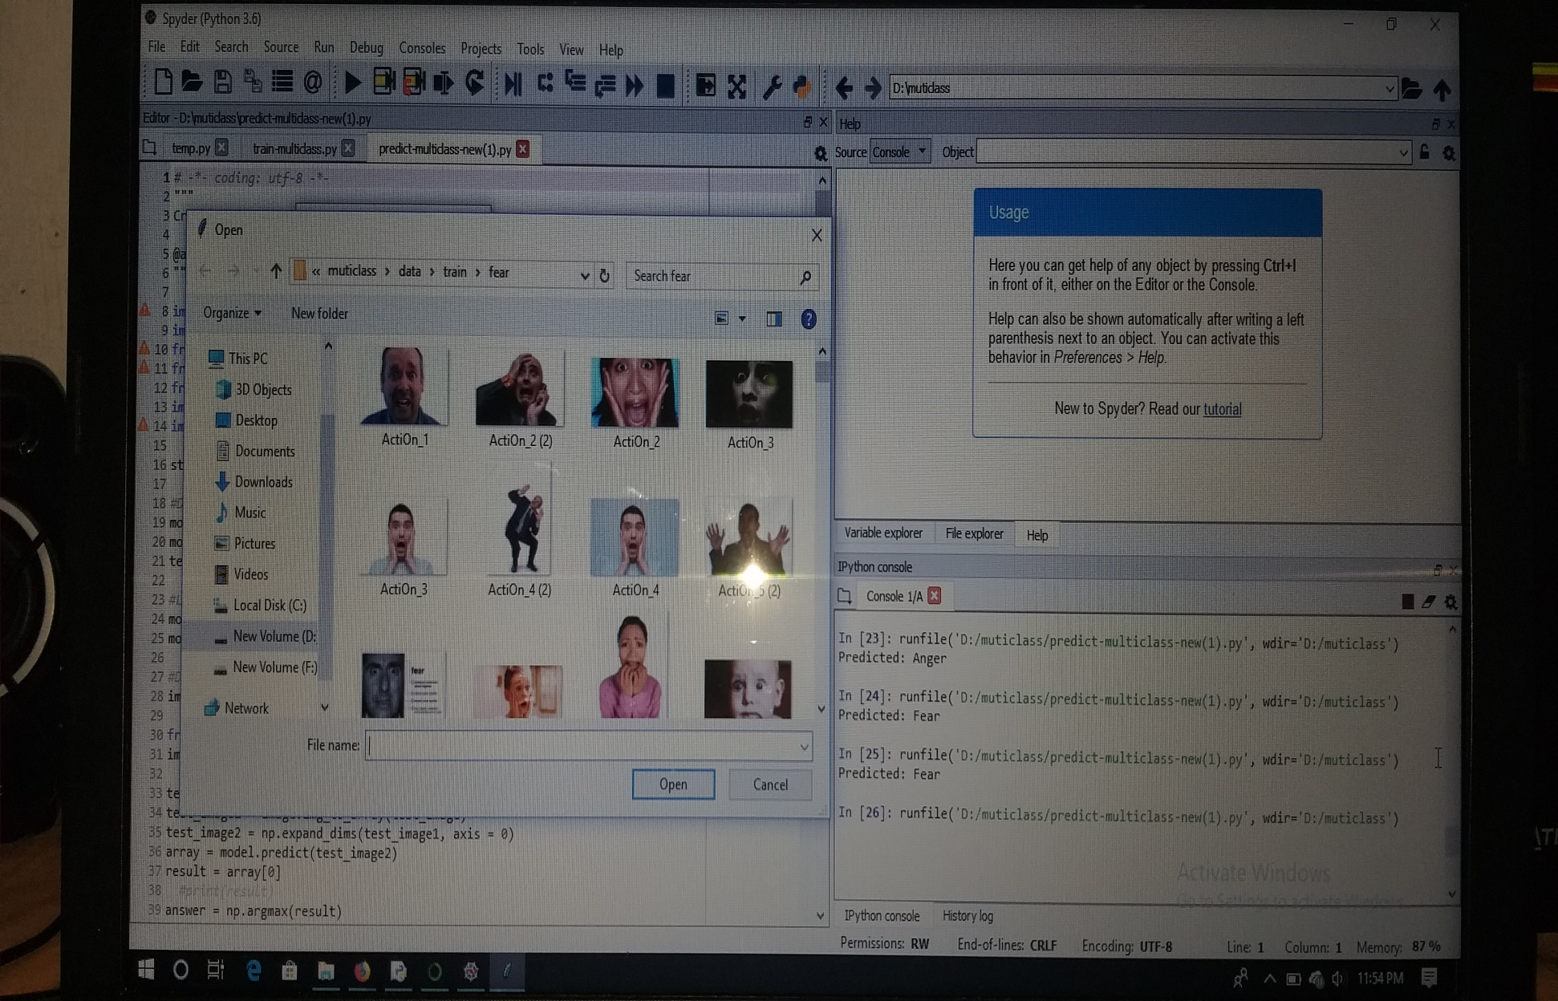
SCREEN SHOTS
FEAR

Slide 22
END

